Slide 1
EXPENSE TRACKER
su
GROUP NUMBER : 139
HTNO. | Name
2103A52107 | P. SRIHITHA
2103A52110 | T. SAIPRIYA
2103A52127 | T. SINDHURAJ
2103A52135 | G. CHANDANA
2103A52171 | T. NIHAL
Under the supervision of
T.SAMPATH KUMAR SIR
Associate Professor School of
Computer Science & Artificial Intelligence
Presented for
Milestone 3-Final Minor Project Review
Date:26-04-2024

Slide 2
Outline of the Presentation
S. No | Topic
1 | Abstract
2 | Motivation and Background
3 | objectives
4 | Introduction
5 | Literature review
6 | Existing system, disadvantages, Existing methodology
7 | Elements used in project, Result screens
8 | Conclusion

Slide 3
Abstract
In a period when financial management is important, the need for effective financial management is reaching critical levels. Expense Tracker project aims to meet this need by offering user-friendly and efficient solutions for individuals and businesses to manage their expenses. Users can easily access their expenses through a simple and direct interface, categorize them according to customizable labels, and view their spending patterns through graphs and reports.

Slide 4
Motivation and Background
We are comitted to this project(expense tracker) because it is to gain better control and understanding of the finances.By tracking expenses,we can identify spending patters,set financial goals,and ultimately improve financial management.The program provides greater financial security and peace of mind by providing the opportunity to improve spending discipline.
Expense tracker applications have arisen as famous devices for people trying to deal with their accounting records all the more actually in an undeniably computerized world. In the past, people tracked their expenses manually using things like spreadsheets or pen and paper. In any case, these techniques were many times tedious, inclined to mistakes, and needed ongoing bits of knowledge into ways of managing money. The approach of cell phones and portable applications changed costs by offering clients helpful, available, and highlight-rich answers for screening their monetary exercises in a hurry.

Slide 5
Introduction
The project aims to provide users with a user-friendly platform to track their expenses effortlessly. Whether it's managing monthly budgets, allocating expenses, our platform has the functionality to meet a variety of financial management needs.It is an essential tool for effective financial management.In a world where financial literacy matters,our tracker provides expense recording,accurate categorization.A user-friendly interface it allows them to easily record expenses,track expenses,identify trends and make strong security decisions,ensuring data security and privacy.

Slide 6
Objectives
Budgeting
Financial awareness
Expense analysis
Data security and privacy
Customisation and flexibilty
Integration and compatibility

Slide 7
Literature Review
The effect of mobile banking on household welfare and financial literacy" by Rajalaxmi Kamath and Amrit Judge (2017): This study investigates how financial literacy and household welfare are affected by mobile banking in India, which frequently offers features for tracking expenses.
By M. Hogqvist, J. Persson, and C. Hall, "Mobile Personal Finance Management". This study looks at how mobile personal finance management apps can assist users in creating budgets, keeping track of their spending, and managing their money more skillfully. It explores the attributes and capabilities of current applications and makes suggestions for their future develop

Slide 8
EXISTING SYSTEM
Mint
YNAB(You Need a Budget)
PocketGuard
Expensify
Wally
Goodbudget

Slide 9
Disadvantage of Exsisting system
1. Data privacy concerns arise due to the collection and storage of sensitive financial information within expense tracker systems, raising issues of security and confidentiality.
2. Accuracy issues within expense tracker projects may result in discrepancies in financial records and reporting, undermining the reliability and trustworthiness of the data.
3. The cost involved in implementing and maintaining expense tracker projects could be a significant disadvantage, especially for individuals or businesses with limited financial resources.
4. Limited customization options may restrict users from tailoring the expense tracker to their specific needs or preferences, leading to dissatisfaction with the user experience.
5. Inaccuracy in automatic categorization of expenses within expense tracker projects may require manual intervention, consuming additional time and effort for users.
6. The time investment required for inputting and managing expenses within the expense tracker can be burdensome, particularly for users with busy schedules.

Slide 10
Existing methodology
To evaluate the effectiveness, usability, and impact on personal finance management of expense tracker apps, existing research employs a variety of methodological approaches. Survey instruments are frequently used in quantitative studies to collect information about user demographics, app usage patterns, and financial outcomes. For instance, scientists might manage pre-and present mediation reviews on measure changes in monetary ways of behaving and mentalities among application clients. Longitudinal studies, which track user engagement and behavior over time, may also be carried out by researchers to gain insight into the viability of app usage and its long-term effects on financial well-being. Additionally, qualitative research techniques like focus groups and interviews are frequently used to investigate users' experiences, perceptions, and preferences regarding expense tracker apps. The underlying motivations, obstacles, and challenges associated with app adoption and usage are illuminated by these qualitative insights, which provide valuable context and nuance to complement the quantitative findings.

Slide 11
Gaps identified
Financial record-keeping inefficiencies and errors are frequently the result of the burden of manual entry that comes with
conventional methods of tracking expenses. Clients might encounter dissatisfaction because of the restricted constant
perceivability into their ways of managing money while depending on manual strategies or less complex cost tracker
applications. Reconciliation challenges emerge when clients endeavor to adjust information between their cost tracker
application and other monetary stages, prompting irregularities and convenience issues. Numerous clients battle with the
trouble in order of costs inside their tracker application, bringing about misallocation of assets and off base monetary
detailing. Users are unable to reduce the amount of time spent manually entering data because of some expense
tracker apps' lack of automation features.

Slide 12
Problem Identification
Manual entry: The burden ofis that users frequently find it tedious and time-consuming to manually enter their expenses into the app, which can result in inconsistent data and user fatigue.
Restricted Continuous Perceivability: Many expense tracker applications need constant updates on spending, making clients have postponed or off base experiences into their monetary exercises. Disjointed user experiences and data inconsistencies result from integration difficulties with other financial platforms and services.
Difficulty in Categorization:The app makes it difficult for users to accurately classify expenses, which can result in misallocating funds and inaccurate financial reporting.
Lack of Automation: Users are forced to perform repetitive manual tasks due to a lack of automation features, which reduces efficiency and user satisfaction.
Privacy concerns: Users are wary of giving sensitive financial information to expense tracker apps because they are concerned about the security and privacy of their data.
Problems with Accessibility: Some expense tracker apps don't have accessibility features, so people with disabilities can't fully use the app's features.
Absence of Customization: Clients feel restricted by the absence of customization choices, keeping them from fitting the application to their particular monetary requirements and inclinations. Insufficient Insights: Expense tracker apps frequently provide users with insufficient or generic insights, making it difficult to obtain information that can be used to make financial decisions.

Slide 13
Elements used in the Project
User Interface (UI):
The project features a user-friendly graphical user interface (GUI) designed for ease of use and navigation.
UI elements include buttons, text fields, text areas, labels, and themes to enhance the visual appeal and customization options.
Expense Logging: Users can manually enter their expenses into the app, including optional notes and information like the amount spent, date, category (such as transportation or groceries), and category.
Financial plan The board: Clients can set financial plans for various cost classifications and track their spending against these financial plans. Visual indicators or notifications may be provided by the app to notify users when their budget limits are approaching or exceeding.
Real-Time Expense Tracking: The app provides instantaneous visibility into users' financial transactions and current spending status by providing real-time updates on their spending activities.
Classification The executives: Clients can coordinate their costs into adjustable classes to work with following and examination. Food, housing, transportation, entertainment, and utilities are all common categories.

Slide 14
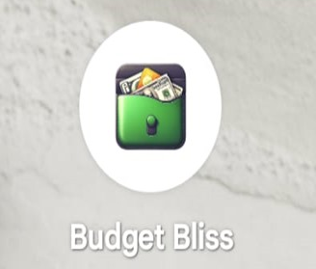
RESULT SCREENS
LOGO

Slide 15
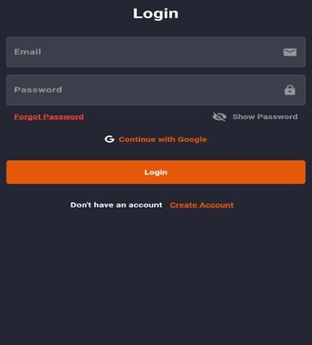
RESULT SCREENS:
LOGIN PAGE

Slide 16
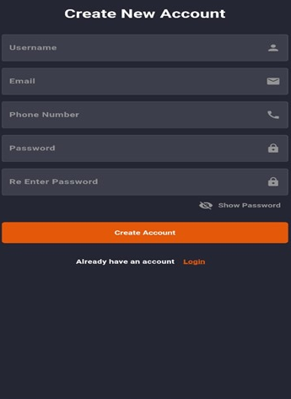
RESULT SCREENS:
ACCOUNT CREATION

Slide 17
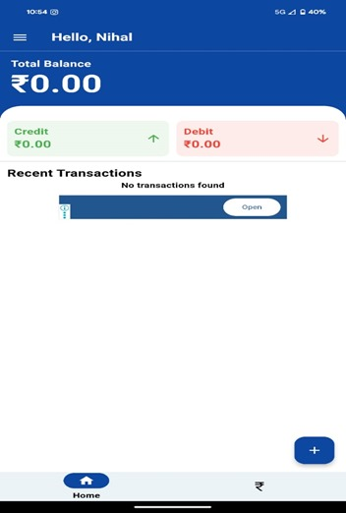
RESULT SCREENS:
USER INTERFACE

Slide 18
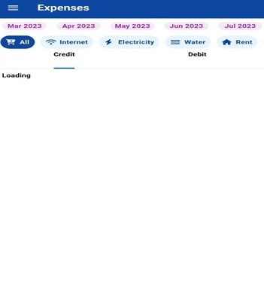
RESULT SCREENS:
USER INTERFACE

Slide 19
Comparative study of proposed and existing systems
1. Highlights and Functionality:- The highlights and usefulness presented by the proposed expense tracker framework with those of existing frameworks. Assess perspectives, for example, cost logging, financial plan the executives, information perception, receipt checking, ledger joining, objective setting, and security highlights.
2. Client Experience:- Evaluate the client experience of the two frameworks, including convenience, route, instinct, and general plan. Take into consideration things like the responsiveness, visual appeal, and customization options of the user interface.
3. Automation and integration of data:- Analyze the degree of information incorporation and robotization capacities between the proposed framework and existing frameworks. Assess the degree to which manual data entry is required and how well each system integrates with external data sources like bank accounts.
4. Real-Time Notifications and Updates: - Investigate the capacity of the two frameworks to give constant updates on spending exercises and send ideal warnings to clients in regard to financial plan edges, charge installments, and sporadic spending designs. Evaluate the viability of these highlights in keeping clients educated and locked in.
5. Privacy and Security: - Assess the safety efforts carried out by the two frameworks to safeguard clients' delicate monetary information. Encrypting data, using secure authentication methods, adhering to privacy laws, and taking precautions to stop unauthorized access or data breaches are all things to think about.

Slide 20
Future Scope
The future scope of Expense Tracker application are:
Artificial Intelligence
Cryptocurrency Support
Smart Expense prediction
Augmented Reality
Collaborative Budgeting Features
Integration with smart devices
Customizable Reporting and Dashboards

Slide 21
Conclusion:
Expense Tracker project provides individuals with a roadmap towards financial independence and security.By actively monitoring spendings, setting budget goals and improving financial management,individuals can gain a better understanding of finances. In conclusion, apps that track expenses are useful for controlling one's finances. These apps give users the ability to control their financial futures by making use of cutting-edge technology and a user-friendly design. With highlights like cost logging, spending plans on the board, and continuous bits of knowledge, clients can pursue informed choices to accomplish their monetary objectives and construct a solid monetary future.

